Slide 1

Travis Patt
Cybersecurity Analyst
Bachelors Cybersecurity & Information Assurance

Slide 2

Take-Home Technical
1337CorpFirewall.csv
1337CORPSchedule.csv
1337CORPSyslogs.csv
1337CORPadserver.csv

Slide 3
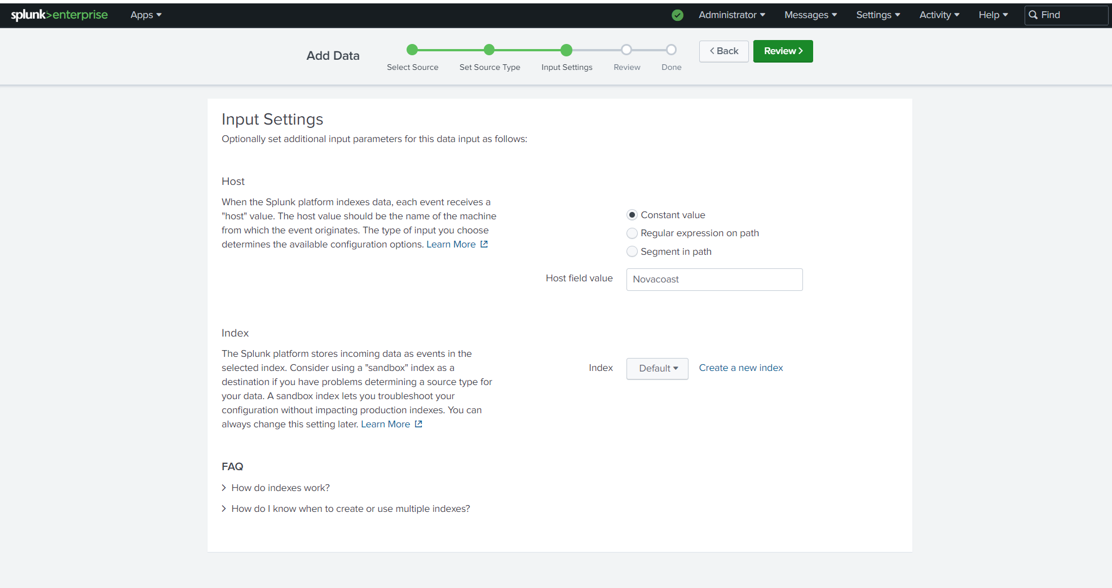
Splunk & Initial data ingestion
Splunk already downloaded and setup with Forwarders and Index/Search Head.
Ingested the .csv files into Splunk. Set the Host Field as “Novacoast” for easier parsing.
Noticed the Timestamp was in Unix Epoch time. Thankfully Splunk automatically converts that without an Eval statement.

Slide 4
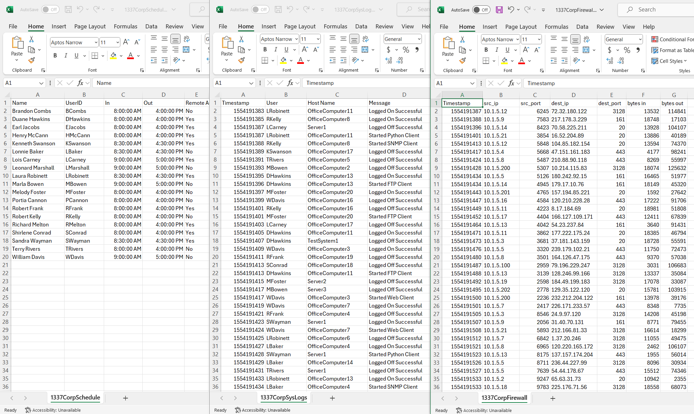
1. Get a general feel of the data
Determine what is normal/abnormal in 1337Corps environment.
Look at CorpSchedule for employees, their normal hours and Remote status (Y/N).
1337CorpFirewall has bytes in & bytes out fields. Let’s start there.

Slide 5
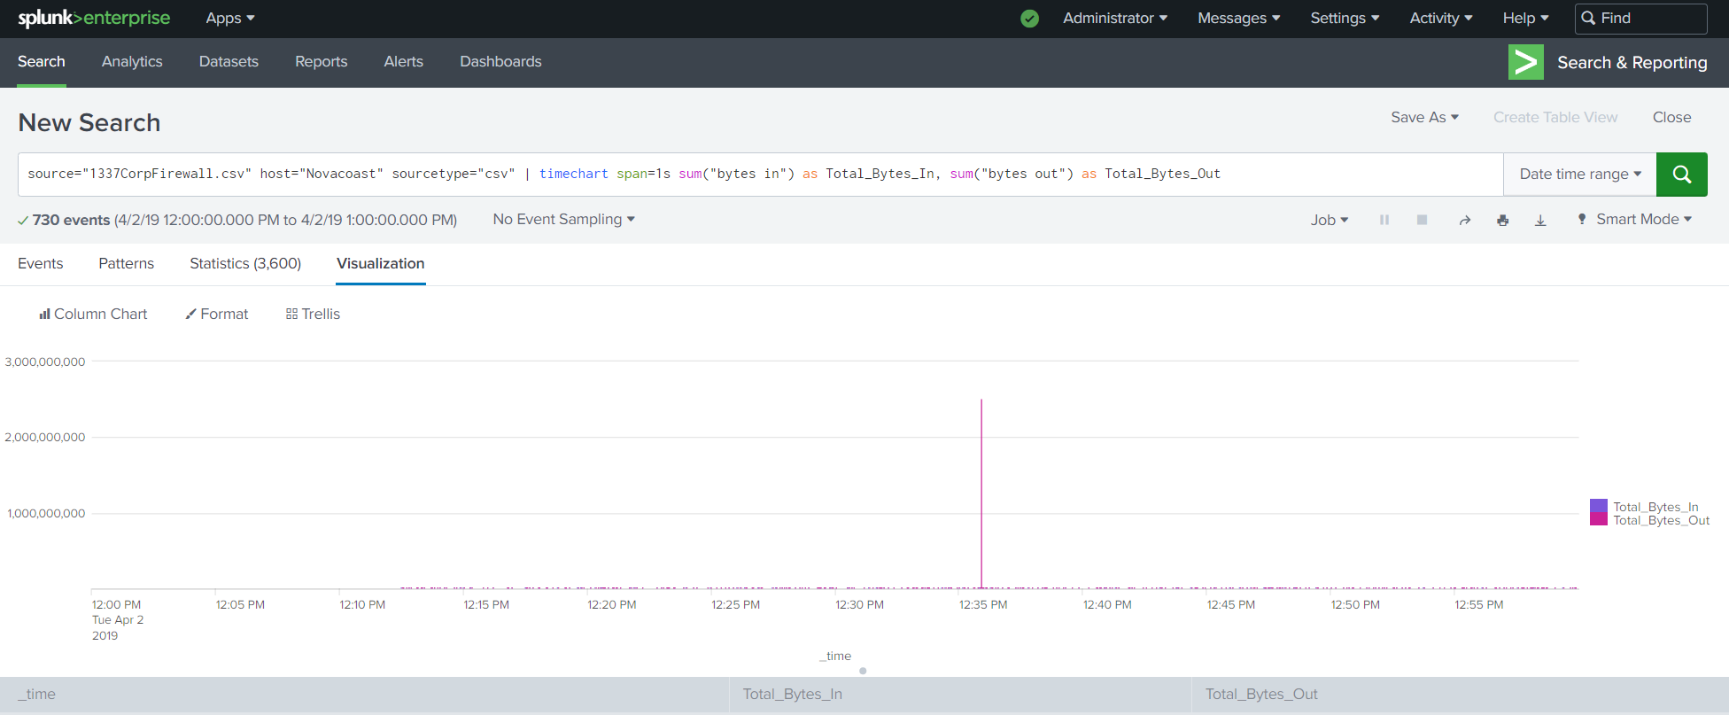
2. Look for suspicious activity
Do an SPL Query to see if any unusual activity stands out.
Bytes in/bytes out visualization would show any spikes in network traffic.
Interesting. One event stands out significantly.
Click on the event to isolate it.

Slide 6
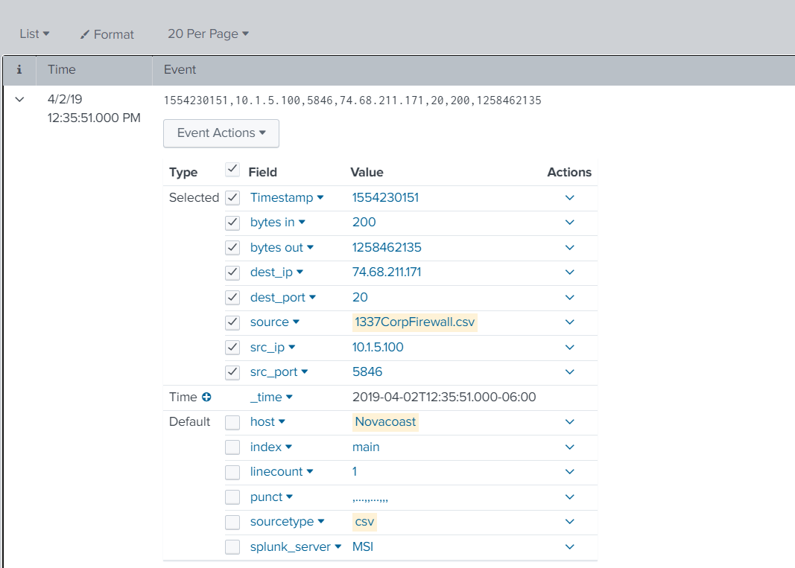
3. FTP Event
_time = 2019-04-02 12:35:51 or Apr 2, 2019 12:35:51 PM
Bytes out = 1.17 GB
Dest_port 20 is for FTP. FTP is normal activity for the company.
VirusTotal scan of dest_ip 74.68.211.171 comes back clean. Probably normal.

Slide 7
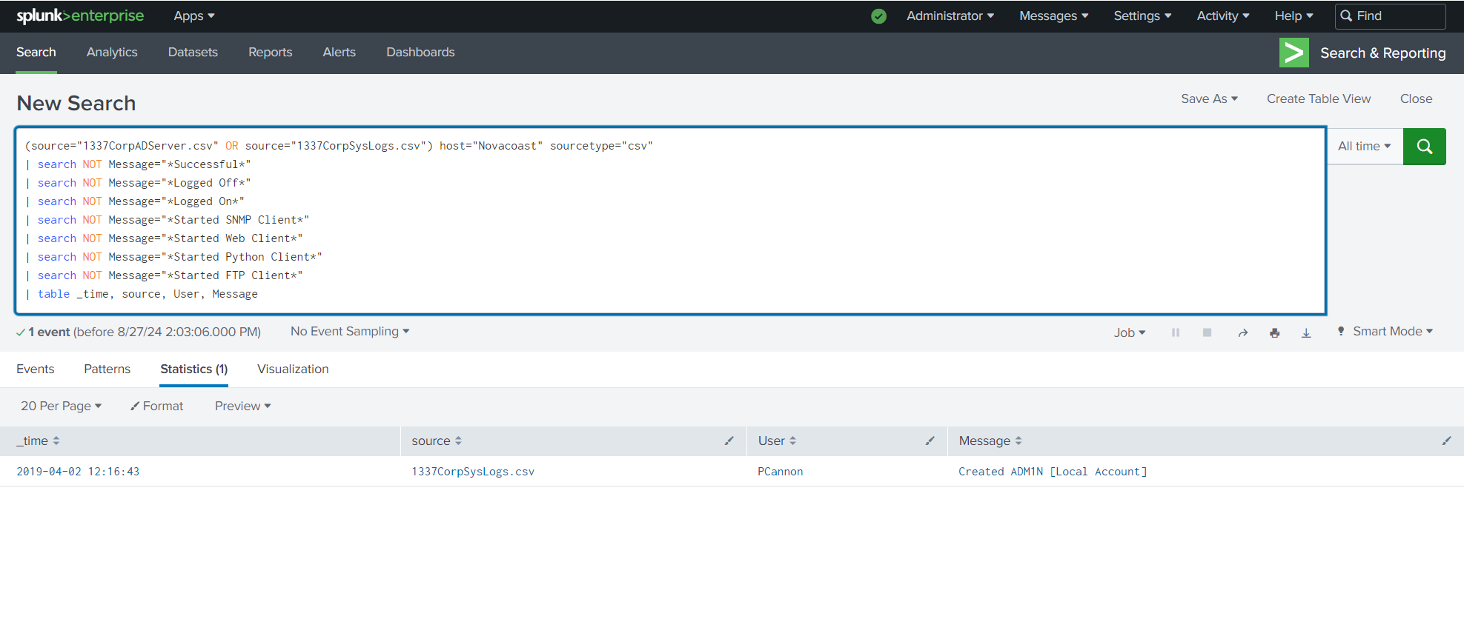
4. Look for other suspicious activity
Parse the Logs to see if there were any Unsuccessful Logins.
Most inefficient SPL Query ever------------------------→
Used process of elimination to get rid of all legitimate activity.
Viola! Was left with this suspicious event: creation of local Admin account named “ADM1N” by PCannon.

Slide 8
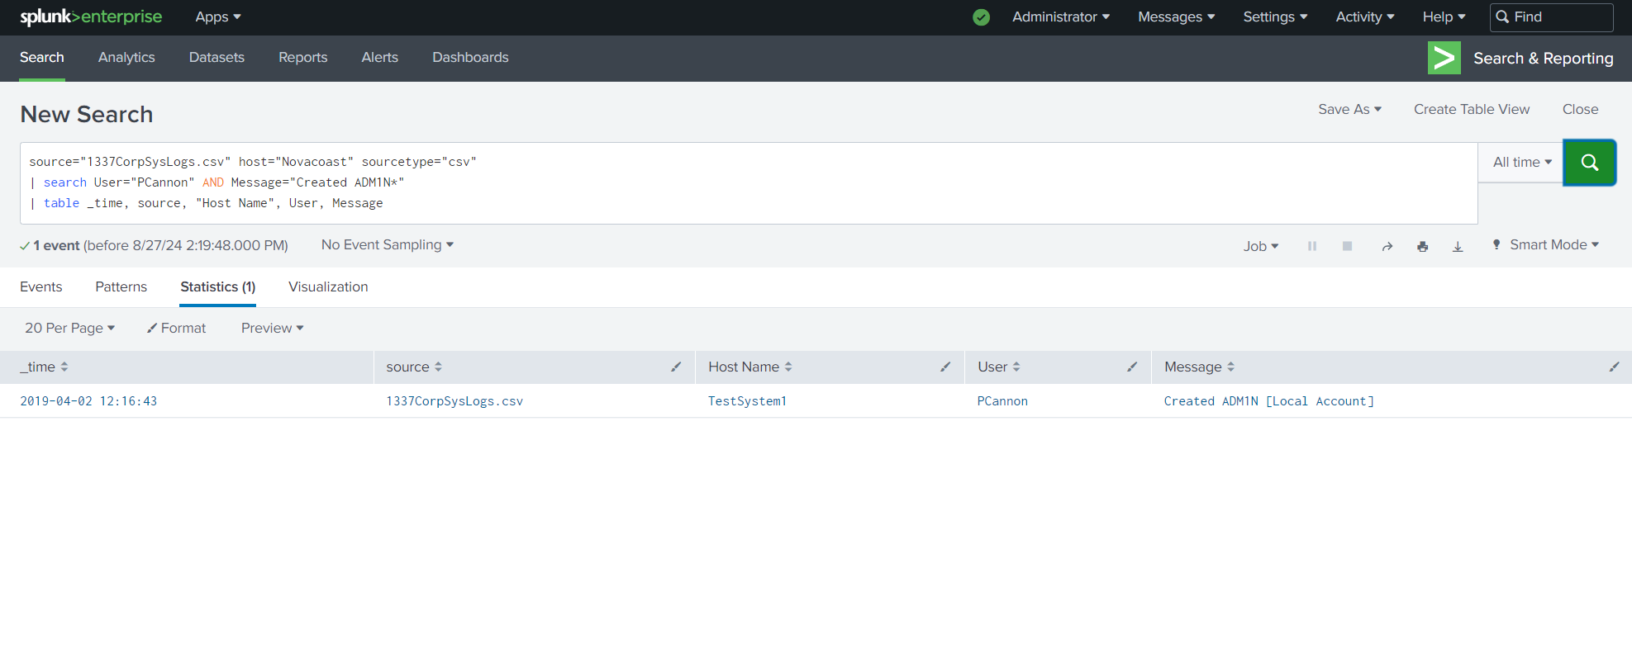
5. Determine if that activity is normal
Give the event some context. ADM1N is a suspicious name. but maybe it is legitimate.
Find out which System the account was created on.
The fact that it’s created on TestSystem1 is also suspicious.
Could this event be correlated to the FTP Event?

Slide 9
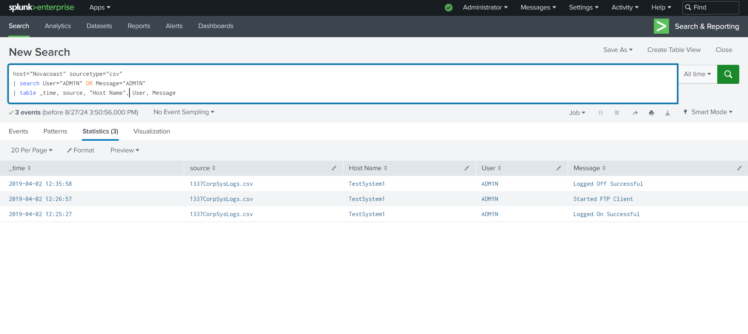
6. Correlate the events pt.1
Let's see if we can track all the actions of the ADM1N account.
It seems that the ONLY thing ADM1N did was logon, start the FTP service, then logout.
Did the FTP Event happen within this window?
Yes. It happened at 12:35:51. Between the Start of the FTP client & right before Logoff.

Slide 10
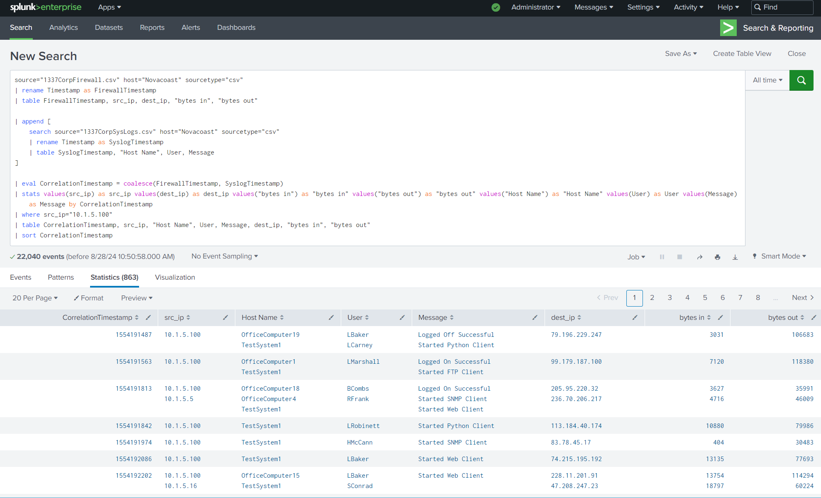
7. Correlate the events pt.2
We know Pcannon created ADM1N on TestSystem1.
Let’s correlate TestSystem1 to the IP address responsible for the FTP Event: 10.1.5.100.
Every instance of the IP 10.1.5.100 correlates to a Login involving TestSystem1 via Timestamp.
TestSystem1 IP = 10.1.5.100

Slide 11
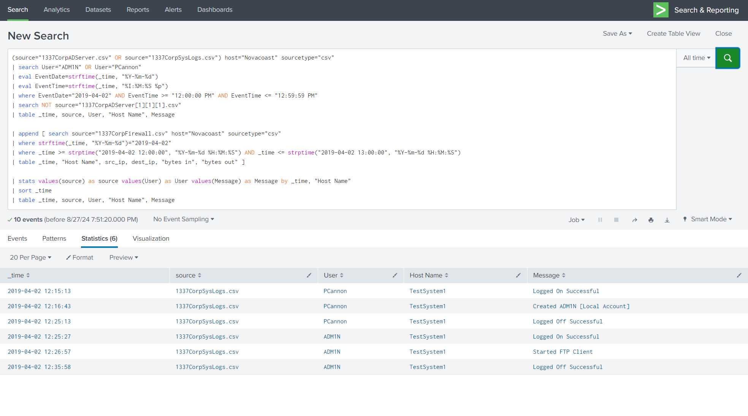
8. Timeline of events
Timeline
1. Pcannon logs on to TestSystem1.
2. Creates ADM1N.
3. logs off her account.
4. Signs into the ADM1N account.
5. Starts the FTP service.
6. Exfiltrates the data.
7. Then logs off ADM1N immediately after the data exfiltration event.

Slide 12
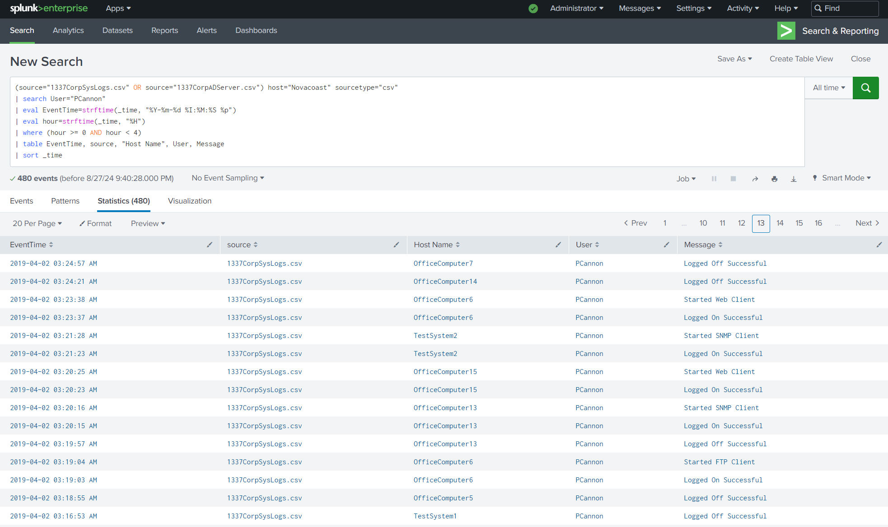
9. Additional suspicious activity
Very damning evidence in totality.
Does Portia Cannon engage in additional suspicious activity?
Yes. She is not supposed to have Remote Access. Yet she logs in to work repeatedly outside of work hours (8am – 4pm), when the offices are closed.
3am… really? -------------------→

Slide 13
FINAL Findings
User Pcannon (Portia Cannon) Illicitly created the ADM1N account on TestSystem1 (10.1.5.100).
Sequence of events shows that after Pcannon created the account, she logged off of her own account. Then Logged back in under the ADM1N account name to launch the FTP service.
Network traffic shows 1.17 Gigabytes of data was exfiltrated to an unusual IP (74.68.211.171). The FTP Event is the only time that destination IP shows up in the logs, signifying that it is not a regular destination IP address used for work purposes.
Pcannon also Logs-in Remotely when not permitted.
Questions & Answers

